Slide 1
Today’s Agenda:
Discuss the role of domestic politics (e.g. bureaucracy) in foreign policy making
Discuss role of psychology in foreign policy decision making
Shift to Western Chapter 1
  A liberal theory of intervention and war

Slide 2
Opening the “Black Box”: Foreign Policy as Rational Action?
In the study of U.S. foreign policy: Blended approach
  Located at the intersection of three spheres of political activity
    Transnational civil society
    The interstate system
    Domestic governing institutions
Notes:
We already know all of this

Slide 3
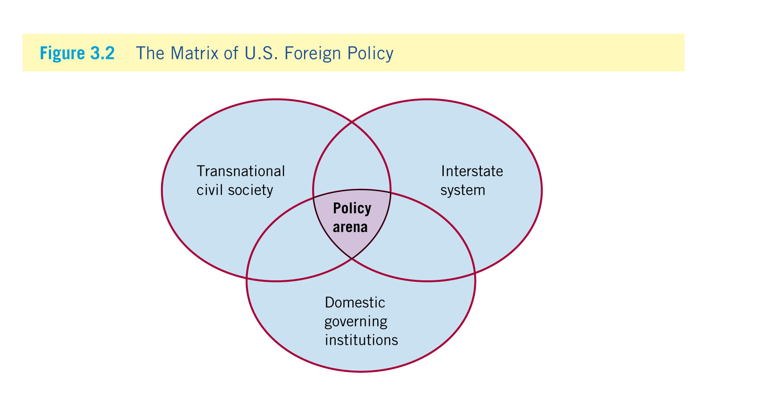
Opening the “Black Box”:
Foreign Policy as Rational Action?
Notes:
Learning Objective: 3.2

Slide 4
The Impact of Civil Society
Iron triangle: A policy subgroup that controls the agenda and policy-making process for a policy area
  Institutional setup that allows interest groups into the process
  Long-standing relationships impenetrable to outside influences (“iron”)
  Includes interest group, congressional committee, and executive branch agency (“triangle”)
    Example: Military-industrial complex (Lockheed Martin and General Dynamics—fighter jet and weapons contracts)
Notes:
Another way to think about domestic politics and unpacking the black box is to look at iron triangles .

Slide 5
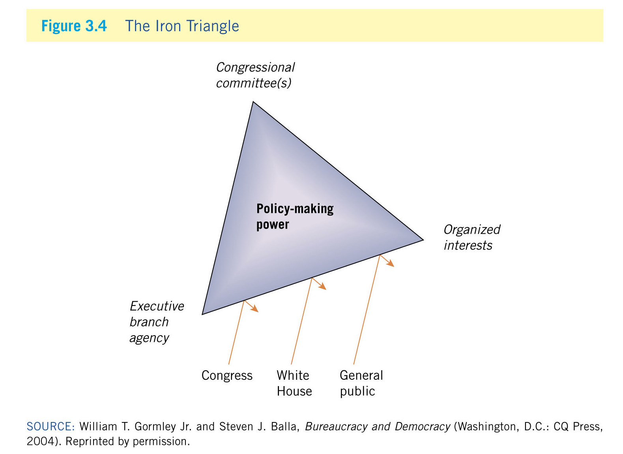
The Impact of Civil Society
Notes:
Learning Objective: 3.3

Slide 6
Coping with Bureaucratic Politics
Patterns of organizational behavior
  Resilience
    Long-lasting nature of organizations: Difficult to change the status quo
  Autonomy
    Independent nature of agencies: Difficult to penetrate from the outside
  Self-interest
    Existence of agency preferences: Competition between agencies for resources, power, and prestige
Notes:
Learning Objective: 3.4

Slide 7
The Human Factor
Beliefs and cognitive “shortcuts”
  Belief systems
    Individual worldviews, formed early in life (and difficult to change), that influence foreign policy goals, strategies, responses to problems
  Policy making is not always rational
    Bounded rationality: Cognitive and structural limits on policy makers
Notes:
Learning Objective: 3.5

Slide 8
The Human Factor
Types of beliefs and their combination
  Principled beliefs: Structured perceptions toward political problems; informed by concerns for principles such as liberty, justice, equality
  Causal beliefs: Perceptions that an individual decision-maker holds regarding likely functional links among policy problems, their sources, alternative solutions
  Principled beliefs and causal beliefs combine to form an operational code: Integrated set of conceptions about political life that forms an individual’s calculations of appropriate/effective policy
Notes:
Learning Objective: 3.5

Slide 9
The Human Factor
Cognitive psychology: The process by which individuals understand the world around them
    Cognitive consistency: The common, subconscious tendency of individuals to perceive new information as consistent with their existing belief systems (think motivated reasoning here)
    Selective perception: The process by which people tend to seek out information that reinforces their worldviews while ignoring contradictory information (selective exposure)
    Use of analogies: Using historical precedents to match new experiences with stored memories
Notes:
Learning Objective: 3.5

Slide 10
The Human Factor
[Cognitive psychology (con’t.)]
    Cognitive closure: The adopted conception of a problem before all the available information has been examined fully and alternative strategies considered
    Bolstering: Once a decision is made, policy makers use that decision to “bolster” or support their initial argument regarding the problem at hand
    Groupthink: overestimation, closed-mindedness, pressures toward uniformity, can all lead to policy “fiascoes”
Notes:
Learning Objective: 3.5

Slide 11
Conclusions:
Take-away from today: When it comes to Foreign Policy and International Relations Theory, we focus on two broad questions:
  (1) does domestic politics matter in the making of foreign policy?
  (2) dos psychology matter in the making of foreign policy?
Answer to this questions often depends on your preference for understanding “complexity” vs “parsimony”

